Slide 1
Big Data Platforms
Lecture 5 – Spark
Lecturer: Shay Sakazi
Teaching Assistants: Yarden Fogel & Roei Arpaly

Slide 2
Previous lecture
Google File System
The Hadoop Distributed File System
HDFS vs. GFS
Map Reduce
Word count example
Map Reduce vs. Parallel RDBMS

Slide 3
Agenda
The Hadoop Eco-System
Pig
Hive
YARN
Spark
Actions vs. Transformations
PySpark

Slide 4
The Hadoop Eco-System

Slide 5
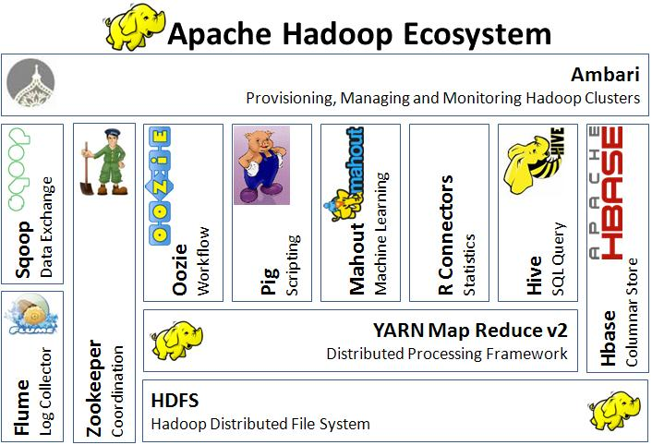
The Hadoop Eco-System

Slide 6
The Hadoop Eco-System

Slide 7
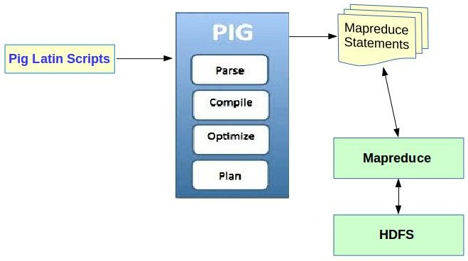

Apache Pig
Apache Pig is a platform for analyzing large data sets

Slide 8

Pig Latin
A=LOAD ''myfile.txt
AS (f1:int,f2:int,f3:int)

Slide 9
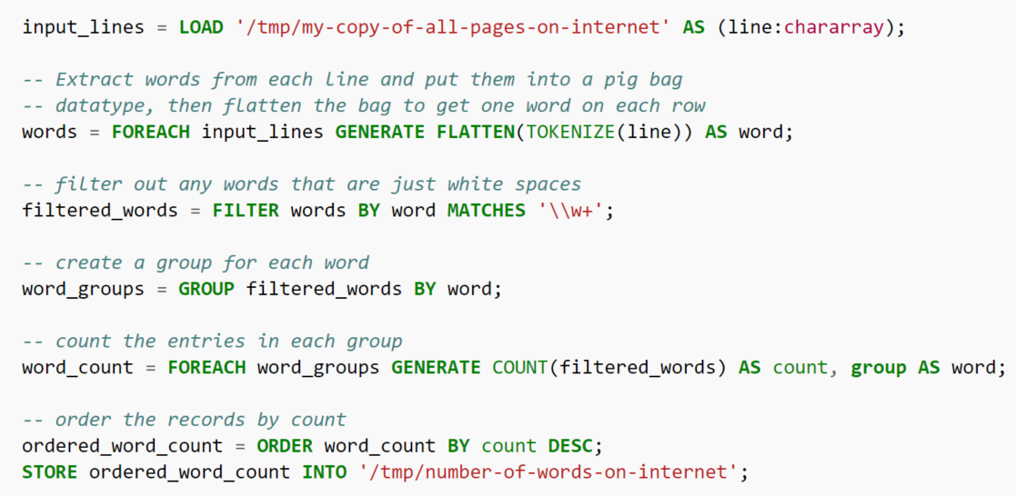
Pig Latin

Slide 10
Apache Pig
Naïve: one M/R task per command
Optimizer: tries to group them
Notes:
In comparison to SQL, Pig
uses lazy evaluation,
uses extract, transform, load (ETL),
is able to store data at any point during a pipeline,
declares execution plans,
supports pipeline splits, thus allowing workflows to proceed along DAGs instead of strictly sequential pipelines.

Slide 11
The Hadoop Eco-System

Slide 12


Hive
Hive is a data warehousing infrastructure
based on Apache Hadoop
Examples of the
Hive Query Language (HQL)
SELECT pv_users.gender, count(DISTINCT pv_users.userid), count(DISTINCT pv_users.ip)
FROM pv_users
GROUP BY pv_users.gender;

Slide 13
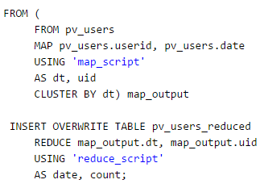
Hive (cont.)
Can integrate HQL and MapReduce

Slide 14
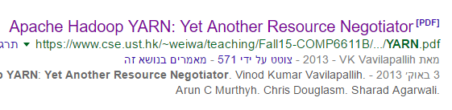
Limitations of the MapReduce Framework
I/O intensive
Writing MapReduce programs can be hard
and repetitive…
Not suitable for complex processing models
Not everything can be solved by mapping & reducing
Not suitable for fast, transactional, queries
Most suitable for batch jobs

Slide 15
The Hadoop Eco-System

Slide 16
YARN: Yet Another Resource Negotiator
YARN design goals
Support for programming model diversity
Not just MapReduce
Flexible resource model
Inherent part of Hadoop 2.0

Slide 17
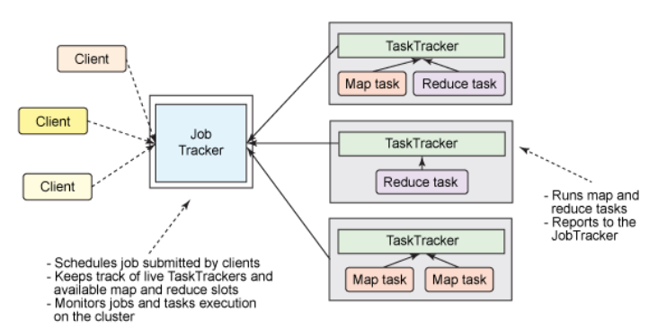
Hadoop v1.0

Slide 18
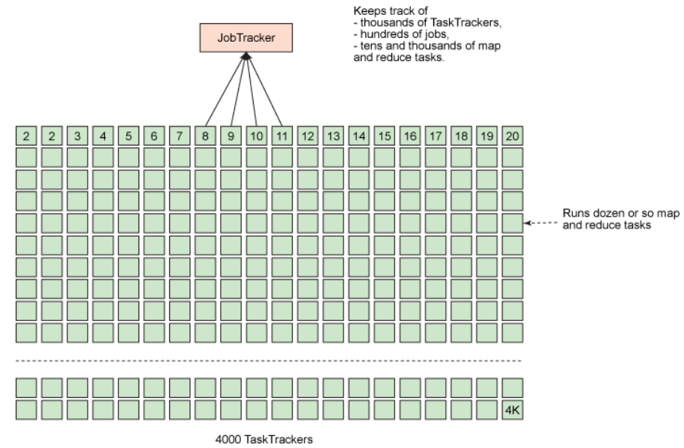
Hadoop v1.0

Slide 19
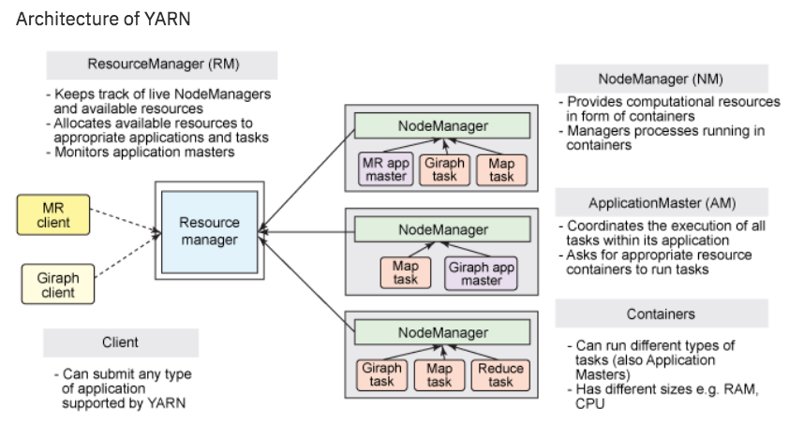
Hadoop v2.0
Notes:
The job scheduling and resource management operations are divided into two separate tasks and managed by different entities
The ResourceManager tracks how many live nodes and resources are available on the cluster and coordinates what applications submitted by users should get these resources and when.
When a user submits an application, an instance of a lightweight process called the ApplicationMaster is started to coordinate the execution of all tasks within the application. This includes:
monitoring tasks
restarting failed tasks
speculatively running slow tasks
calculating total values of application counters.
In v1, all these were assigned to the JobTracker!
The AM can run any type of task, not only M/R jobs!
The NodeManager is a more generic and efficient version of the TaskTracker of V1. Instead of having a fixed number of map and reduce slots, the NodeManager has a number of dynamically created resource containers.

Slide 20
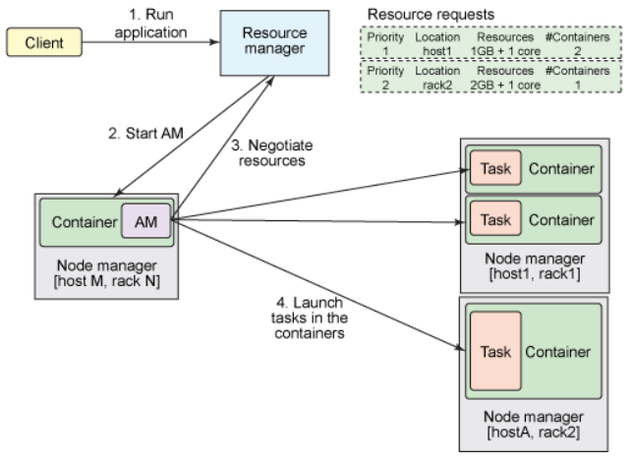
Hadoop v2.0
Notes:
The ApplicationsManager is responsible for accepting job-submissions, negotiating the first container for executing the application specific ApplicationMaster and provides the service for restarting the ApplicationMaster container on failure. The per-application ApplicationMaster has the responsibility of negotiating appropriate resource containers from the Scheduler, tracking their status and monitoring for progress

Slide 21
Apache Spark

Slide 22
Apache Spark
Spark is an open-source distributed general-purpose cluster-computing framework.
Spark performs in-memory computations (most of the processing is done in the RAM of the machines)
Covers a wide range of workloads — batch, interactive, iterative, and streaming (Hadoop is designed mostly for batch)
Some History:
Started as a project in UC Berkeley in 2009
Open-sources (BSD license) in 2010
Donated to the Apache foundation in 2013
Had over 1,000 contributors in 2015, making it the most active Apache project!

Slide 23
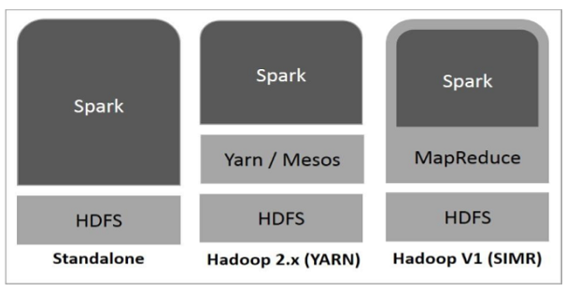
Implementing Spark on Hadoop
Notes:
Standalone − Spark Standalone deployment means Spark occupies the place on top of HDFS(Hadoop Distributed File System) and space is allocated for HDFS, explicitly. Here, Spark and MapReduce will run side by side to cover all spark jobs on cluster.
Hadoop Yarn − Hadoop Yarn deployment means, simply, spark runs on Yarn without any pre-installation or root access required. It helps to integrate Spark into Hadoop ecosystem or Hadoop stack. It allows other components to run on top of stack.
Spark in MapReduce (SIMR) − Spark in MapReduce is used to launch spark job in addition to standalone deployment. With SIMR, user can start Spark and uses its shell without any administrative access.

Slide 24
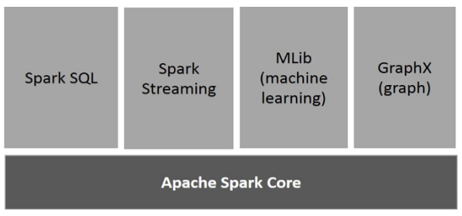
Spark Architecture
Notes:
Apache Spark Core - the underlying general execution engine for spark platform that all other functionality is built upon. It provides In-Memory computing and referencing datasets in external storage systems.
Spark SQL - a component on top of Spark Core that introduces a new data abstraction called SchemaRDD, which provides support for structured and semi-structured data.
Spark Streaming - leverages Spark Core's fast scheduling capability to perform streaming analytics. It ingests data in mini-batches and performs RDD (Resilient Distributed Datasets) transformations on those mini-batches of data.
MLlib (Machine Learning Library) - distributed machine learning framework above Spark because of the distributed memory-based Spark architecture. It is, according to benchmarks, done by the MLlib developers against the Alternating Least Squares (ALS) implementations. Spark MLlib is nine times as fast as the Hadoop disk-based version of Apache Mahout (before Mahout gained a Spark interface).
GraphX - GraphX is a distributed graph-processing framework on top of Spark. It provides an API for expressing graph computation that can model the user-defined graphs by using Pregel abstraction API. It also provides an optimized runtime for this abstraction.

Slide 25
Spark
Classical MapReduce over HDFS
SPARK
Notes:
MapReduce: lot’s of network and I/O during every MapReduce action.
Insight: memory is faster, and sometimes we need to chain M/R tasks (or other data intensive tasks)
Memory ~ x10-100 times faster

Slide 26
Spark pros and cons
Pros:
Works equally well with HDFS or many other file systems, or even cloud-based storage suitable for realtime processing and processing large data on the network
Can be used for iterative execution
Can be used for graph analysis
Great for machine learning algorithms
Cons:
The memory requirement for In-Memory processing is high and difficult to achieve using compute nodes made from commodity hardware
Relative slow for working with small datasets

Slide 27
Resilient Distributed Dataset (RDD)
RDD (Resilient Distributed Dataset) is the fundamental data structure of Spark
Every dataset in Spark’s RDD is logically partitioned across many servers
RDD is fault-tolerant (Automatically rebuild on failure)
Data can be structured or unstructured (can be JSON files/CSV files/databases)
Read Only (but can be transferred)
We can think of RDD as logical abstraction representation of a set of data, spread across multiple machines.
Why to use RDDs?
Give the developers more control and flexibility (you can tell Spark what to do and how to do it)

Slide 28
RDD (cont’d)
Resilient Distributed Dataset (RDD)
An immutable, partitioned collection of elements that can be operated on in parallel
Built via parallel transformation (map, filter)
Can apply parallel transformation to it
Lazy computation
Notes:
RDD is a read-only, partitioned collection of records. RDDs can be created through deterministic operations on either data on stable storage or other RDDs. RDD is a fault-tolerant collection of elements that can be operated on in parallel. Objects need to be passed through the “parallelize” command

Slide 29
Create RDD
Parallelizing an existing collection in your driver program.
Referencing a dataset in an external storage system, such as a shared file system, HDFS, HBase.

Slide 30
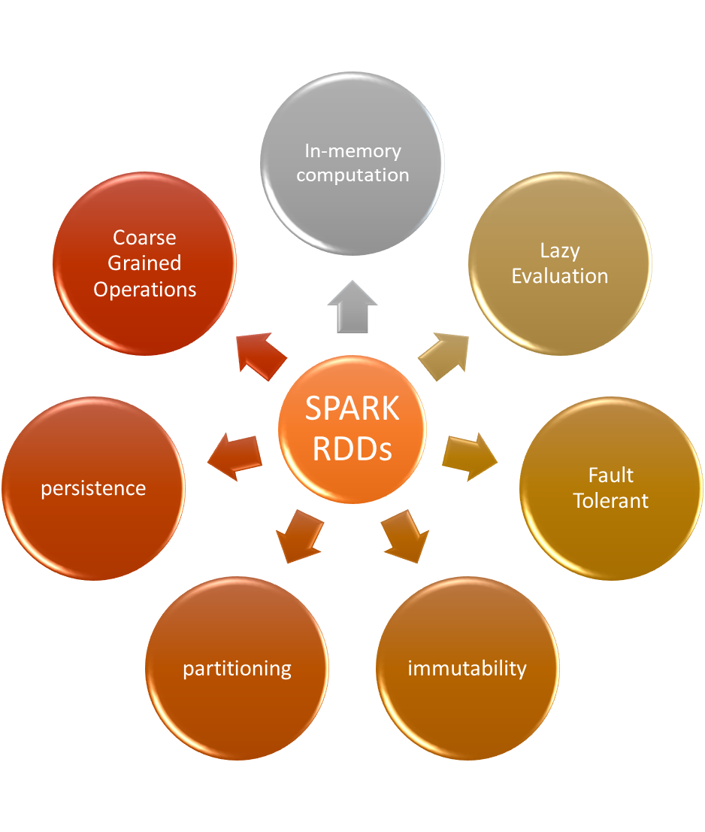
Characteristics of RDD

Slide 31
Limitation of RDD
No Input Optimization Engine
Not Enough Memory
Runtime type safety
Handling Structured Data

Slide 32
RDD Lineage
RDD has enough information about how it was derived from other datasets (its lineage) to compute its partitions from data in stable storage.
Users can control two other aspects of RDDs:
persistence indicate which RDDs they will reuse and choose a storage strategy for them (e.g., in-memory storage).
partitioning ask that an RDD’s elements be partitioned across machines based on a key in each record.
This is useful for placement optimizations, such as ensuring that two datasets that will be joined together are hash-partitioned in the same way.

Slide 33
Operations on an RDD
AKA actions

Slide 34
Spark DataFrame
A DataFrame is a distributed collection of data.
Similar to Pandas DataFrames, Spark DataFrames are organized into named columns (tabular format).
DataFrames can be created from: Structured Data Files (like CSV, JSON, XML) Hive Tables Existing databases
Using Spark DataFrames, it is possible to analyze Peta Bytes of data

Slide 35


Spark vs. Hadoop
Factors | Spark | Hadoop MapReduce
Speed | 100x times than MapReduce | Faster than traditional systems
Written in | Scala | Java
Data Processing | Batch/real-time/iterative/interactive/graph | Batch processing
Ease of use | Compact & easier than Hadoop | Complex & lengthy
Caching | Caches the data in-memory & enhances the system performance | Doesn’t support caching of data

Slide 36
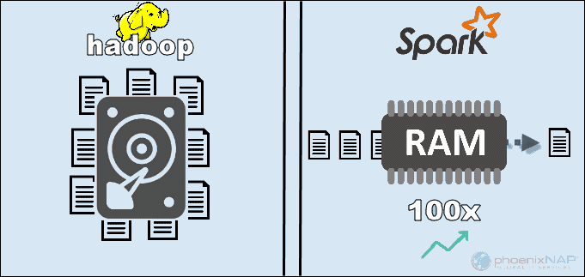
Spark vs. Hadoop (cont’d)
The main reason for this supremacy of Spark is that it does not read and write intermediate data to disks but uses RAM.
Hadoop stores data on many different sources and then process the data in batches using MapReduce

Slide 37
Actions vs. Transformations

Slide 38
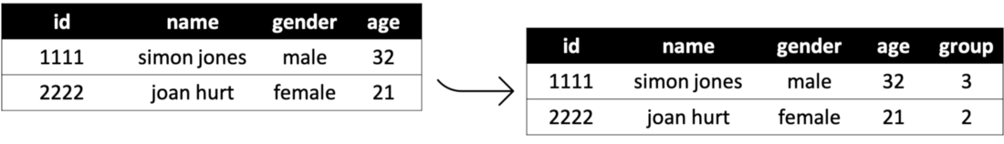
Transformation
A transformation is every Spark operation that returns an RDD.
When we build a chain of transformations, we add building blocks to the Spark job, but no data gets processed.
That is possible because transformations are lazy executed.
Spark will calculate the value when it is necessary.
This means that Spark needs to recompute the values when we re-use the same transformation. We can avoid that by using persist or cache functions.
rdd Transformation Spark
Transformation that creates a data frame with a new column group using the age column of the input data frame. Link

Slide 39
Actions
Actions, on the other hand, are not lazily executed.
When we put an action in the code and Spark reaches that line of code when running the job, it will have to perform all the transformations that lead to that action to produce a value.
Producing value is the key concept here. While transformations return one of the Spark data types, actions return a count of elements (for example, the count function), a list of them (collect, take, etc.).
Or store the data in external storage (write, saveAsTextFile, and others).

Slide 40
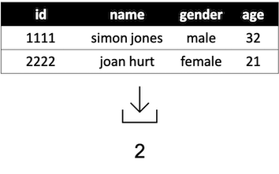
Actions (cont’d)
A spark operation that either returns a result or writes to the disc. Examples of action include count and collect.
An action that returns the total number of rows in a DataFrame.

Slide 41
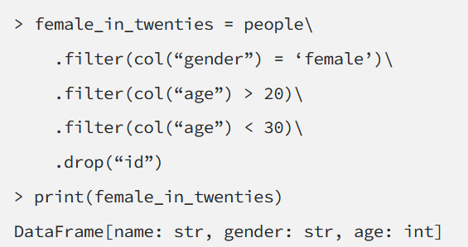
Lazy and Eager Execution
Transformations are evaluated in a lazy fashion.
This means no Spark jobs are triggered, no matter the number of transformations are scheduled.
Four transformation operations on the people DataFrame, which has not triggered any jobs but returns the expected skeleton of the result.

Slide 42
Why Use Lazy Execution?
Lazy execution is a common pattern in functional and Big Data languages, e.g., Spark, Scala, Java Stream API, etc.
Adopting lazy evaluation enables:
avoiding all data loads at the first step, which is technically impossible with large datasets
parallelizing multiple transformations on a single data element using a single thread on a single machine
applying various optimizations automatically
All actions are executed in an eager manner where all unevaluated transformations are executed prior to the action.

Slide 43
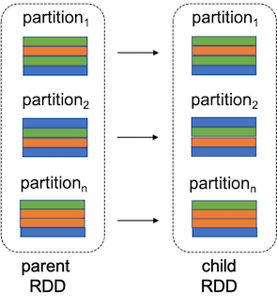
Narrow Transformation
Transformations are either narrow or wide.
In a narrow transformation, the data required to compute the records in a single partition of the resultant RDD.
Reside in at most one partition of the parent RDD
Examples of narrow transformation include filter, drop, coalesce, etc.

Slide 44
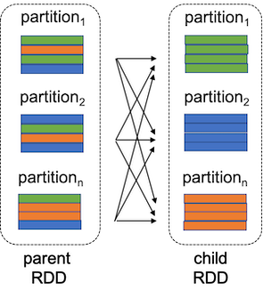
Wide Transformation
In a wide transformation, the data required to compute the records in a single partition of the resultant RDD may reside in multiple partitions of the parent RDD.
Examples of wide transformation include distinct, groupBy, repartition, etc.

Slide 45
Shuffle Operations
A shuffle operation is triggered when data needs to move between executors. It is an essential part of wide transformations, such as groupBy, and some actions, such as count.
In a wide transformation a shuffle operations must be executed.
Let's assume that it is triggered by a groupBy operation.
In this case, to group by color, it will serve best if the record of the same color, i.e., green, blue, and orange, are brought together to their respective partitions.
If the operation followed by the groupBy is a count, then it can be easily be calculated by counting the colors in each of the shuffled partitions

Slide 46
Shuffle Operations Types
There are two sub shuffle operations: shuffle-write and shuffle-read. Which execute in different executors involved in a shuffle.
During shuffle-write, the node convert records in a partition as Unsafe Row — referred to as Tungsten Binary Format.
Then it writes that data to the local disk and sends it across the wire to other executors chosen by the Driver node.
During shuffle-read, the node pulls the data partition and copy the data back to RAM. Then it starts executing the next stage of transformations and actions.

Slide 47
Shuffle - Cons
The transition between stages is a bottleneck for the following reasons:
Synchronization delay, since the next stage cannot start until every task on all partitions on all nodes in the current stage is completed
Disk IO due to shuffle-write and shuffle-read
Network IO due to shuffle data transfer
It is, therefore, necessary to design code in such an order that it reduces shuffling as much as possible.

Slide 48
PySpark

Slide 49

What is PySpark
PySpark is an interface for Apache Spark in Python.
It not only allows you to write Spark applications using Python APIs, but also provides the PySpark shell for interactively analyzing your data in a distributed environment.
PySpark supports most of Spark’s features such as Spark SQL, DataFrame, Streaming, MLlib (Machine Learning) and Spark Core.
Link

Slide 50

PySpark Architecture
Apache Spark works in a manager-worker architecture where the manager is called “Driver” and workers are called “Workers”.
When you run a Spark application, Spark Driver creates a context that is an entry point to your application, and all operations (transformations and actions) are executed on worker nodes, and the resources are managed by Cluster Manager.

